Slide 1


Preconception Interventions for Infertile Women with PCOS
Dr. Sanskruti Tahakik
Dept. Of Community Physiotherapy
Mgm Institute Of Physiotherapy
Chh. Sambhajinagar

Slide 2
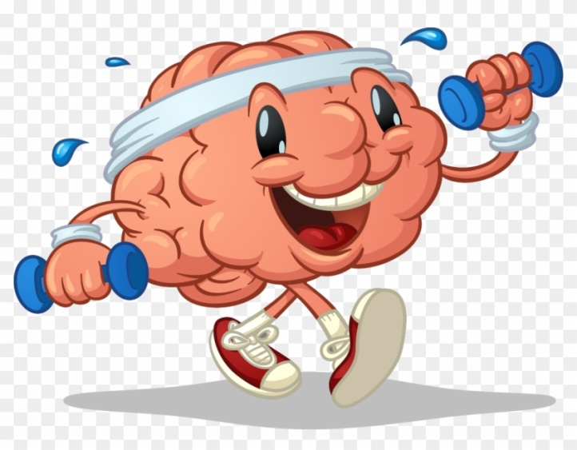
Points to Learn Today…
What is PCOS
What are signs & Symptoms
Diagnostic Criteria
Infertility in PCOS
Interventions to treat PCOS & infertility
Recent trends in Exercise Interventions
Adherence to Exercise

Slide 3

PCOS was originally described in 1935 by Stein & Leventhal.
As syndrome manifested by amenorrhea, hirsutism and obesity associated with polycystic ovaries.

Slide 4
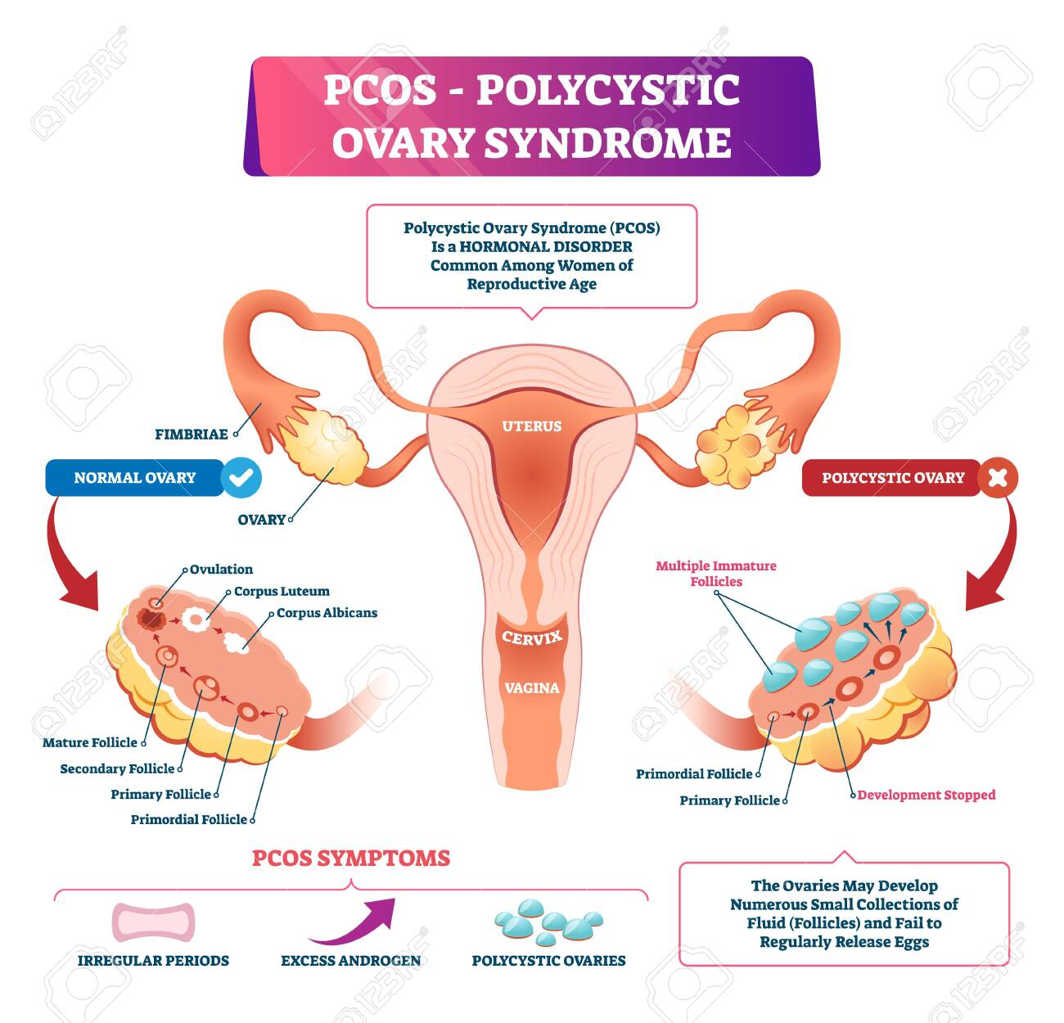

Slide 5
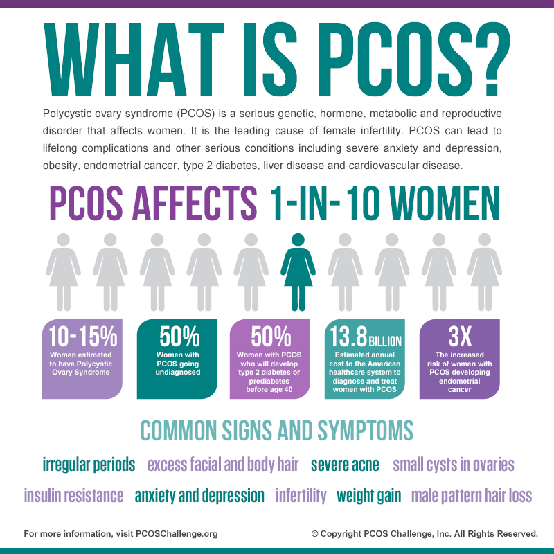

Slide 6
Point to be noted…
In India Prevalence is About 3.7 to 22.5 %.
Exact aetiology pathology of the condition not Known.
Painful & uncomfortable menstruations.
Impact on metabolic & Psychological health.
Androgen excess.
Infertility.

Slide 7
Signs & Symptoms

Slide 8
Infertility
Overweight
High testosterone levels
Hair loss
Insulin resistance
Anxiety & depression
Obstructive sleep apnea

Slide 9
Rotterdam criteria (2 out of 3 )
Hyper- androgenism
(Clinical or Biological )
Menstrual irregularities
(< 9 Cycles / year or > 35 days between cycles
Polycystic ovaries on ultrasonography (>12 antral follicles in one ovary and/or ovarian volume > 10cm3)

Slide 10
Definition :-
Infertility is failure to conceive within one or more years of regular unprotected coitus.

Slide 11
Factors
Hypothalamic- pituitary compartment abnormality
Androgen excess & Hirsutism
Obesity & insulin resistance
Anovulation

Slide 12
Hormonal imbalance
Androgen excess
Insulin resistance
High blood Glucose
Increased production of testosterone
Ovulatory dysfunction

Slide 13

Emotional disturbances
Acne
Hirsutism
Infertility
Weight difficulties
Menstrual Symptoms
Menstrual predictability
Modified PCOSQ a seven-point Likert scale with low score means worse QOL. 30 item questionnaire
Marathi translated Modified Polycystic Ovary Syndrome Questionnaire (MARmPCOSQ)

Slide 14


Yes
Diet
No

Slide 15
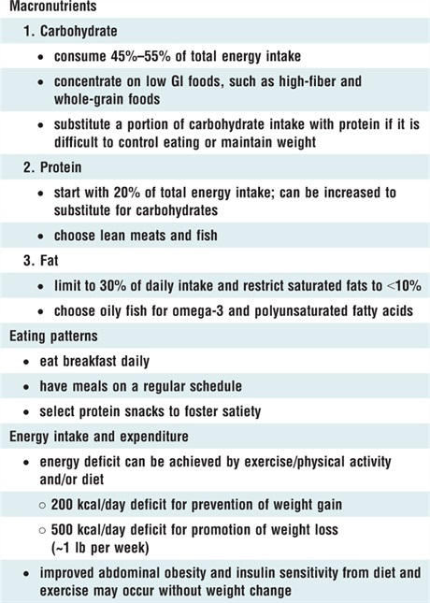

Slide 16
Physical Activity
Improves menstrual cycle
Weight loss
Decrease in Insulin resistance
Decreases testosterone levels & free Androgen index
Restore Physiological reproductive function

Slide 17
What research tells….
The study mentioned that any physical activity can maintain the function of ovaries by increasing insulin sensitivity.
Vigorous exercise will impact adiposity & impact in ovulatory dysfunction & infertility.
Studies suggest that exercise will have a positive impact on ovulatory function & eventually conception but more focused research needed in individualised structured & specific exercise intervention.

Slide 18
Leanne M Redman et al., (2011) conducted a study on obese women having PCOS to investigate the effects of aerobic exercise on insulin sensitivity of women as well as enhancing the reproductive health by improving the ovulatory cycle. In this study, author was not looking for the effect on weight loss. It was reported that regular exercise can regulate the metabolic activity, thereby improving the fertility.

Slide 19
Ida Almenning Kiel, Kari Magrethe Lundgren et al., (2018)
“Effects of high-intensity interval training in women undergoing assisted conception”.
3 sessions / week and was conducted for 10 weeks.
sessions were four bouts of four minute high intensity training and at 85% - 95% of Hrmax.
for each individual Women in the experimental group conceived naturally. Experimental group observed results on obesity and insulin sensitivity post the session.
Diet was not part of the session and all the participants were purely into intervention only. Hence the study could detail on the isolated effects of exercise.

Slide 20
The Protocol

Slide 21
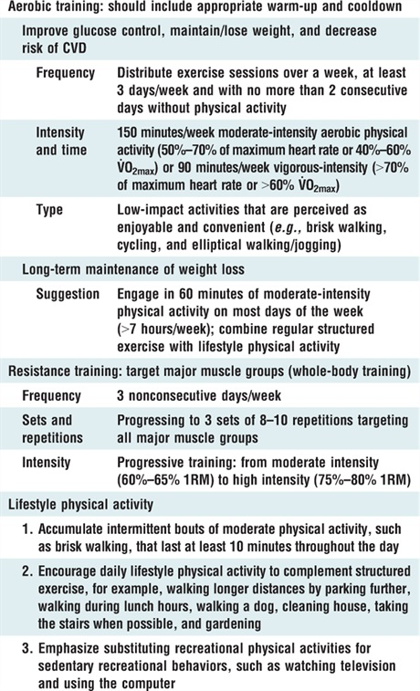
Refer to the International evidence-based guideline for the assessment and management of polycystic ovary syndrome 2018 available at:
www.monash.edu/medicine/sphpm/mchri/pcos

Slide 22
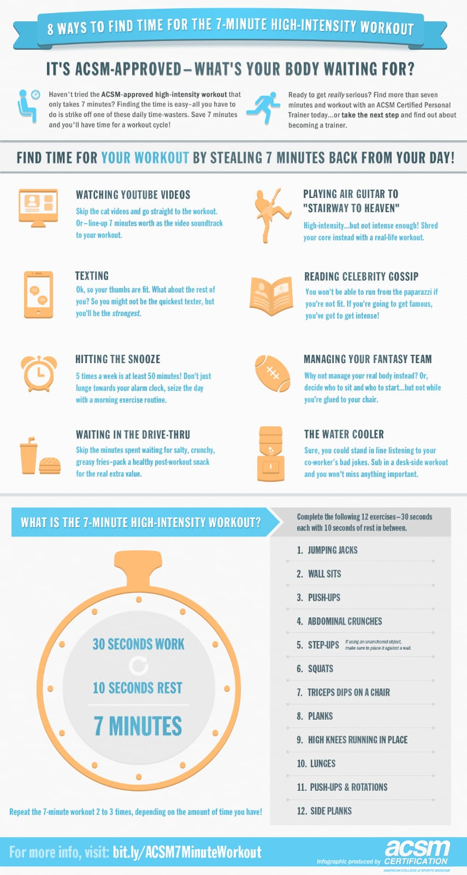

Slide 23
Strategies And Approaches to Change Behaviour & increase Adherence
Building Self-efficacy – Experiencing successful completion of tasks
Brief Counselling and Motivational Interviewing.
Five “A”
Address Agenda
Assess
Advise
Assist
Arrange follow –Up

Slide 24
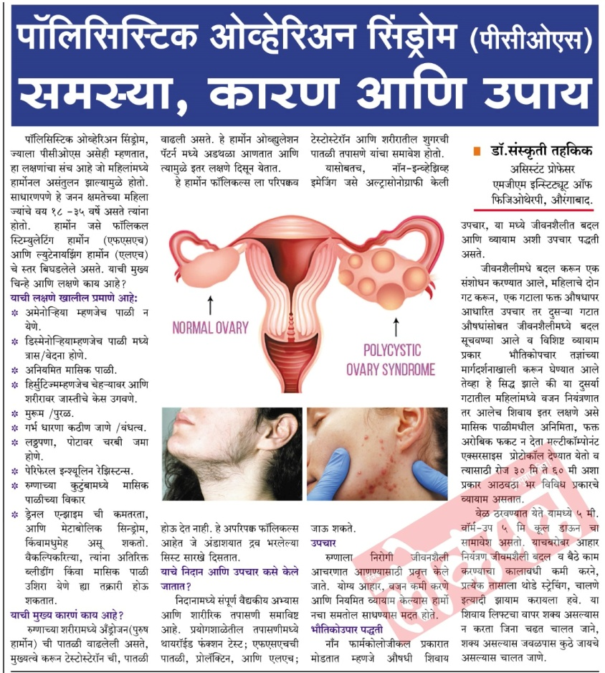

Slide 25
References
DC Dutta’s textbook of gynecology 7th edition.
Kiel IA, Lionett S, Parr EB. Improving reproductive function in women with polycystic ovary syndrome with high-intensity interval training (IMPROVIT): study protocol for a two-centre, three-armed randomised controlled trial. BMJ Open 2020;10: 1-9.
Kiel IA, Lundgren KM, Morkved S et al., Women undergoing assisted fertilisation and high-intensity interval training: a pilot randomised controlled trial. BMJ Open Sport Exerc Med 2018;4:1-8.BMJ Open Sport Exerc Med 2018;4:1-8.
Redman LM, Elkind-Hirsch K, Ravussin E. Aerobic exercise in women with polycystic ovary syndrome improves ovarian morphology independent of changes in body composition. Fertil Steril 2011; 95(8):2696–2699.
Janet W. Rich-Edwards, Donna Spiegelman, Miriam Garland et al., Physical Activity, Body Mass Index, and Ovulatory Disorder Infertility. Epidemiology 2002;13(2)184-190.

Slide 26


